Slide 1
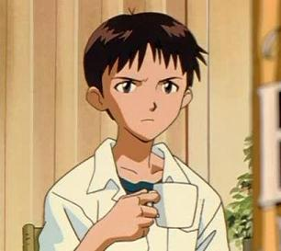
POV Project
Los Moons
Roger Alan Luna Fernandez A00815024
Armando Aguilar Muñiz A01196064
Carlos Salvador Garza Garza A01195968

Slide 2
Introduction
The scene we decided to make is from Neon Genesis Evangelion, it pictures Shinji and Asuka after Shinji stops the third impact, it shows them as their only apparently survivors.
Neon Genesis Evangelion is an anime series which was aired in 1995 and 1996 the series is often is subject of debates within its fans because of its deep religious symbolism and its psychological themes of its characters.
Our motivation was we are all fans of the series and after looking at the scene we thought we could create it in POV with some changes

Slide 3
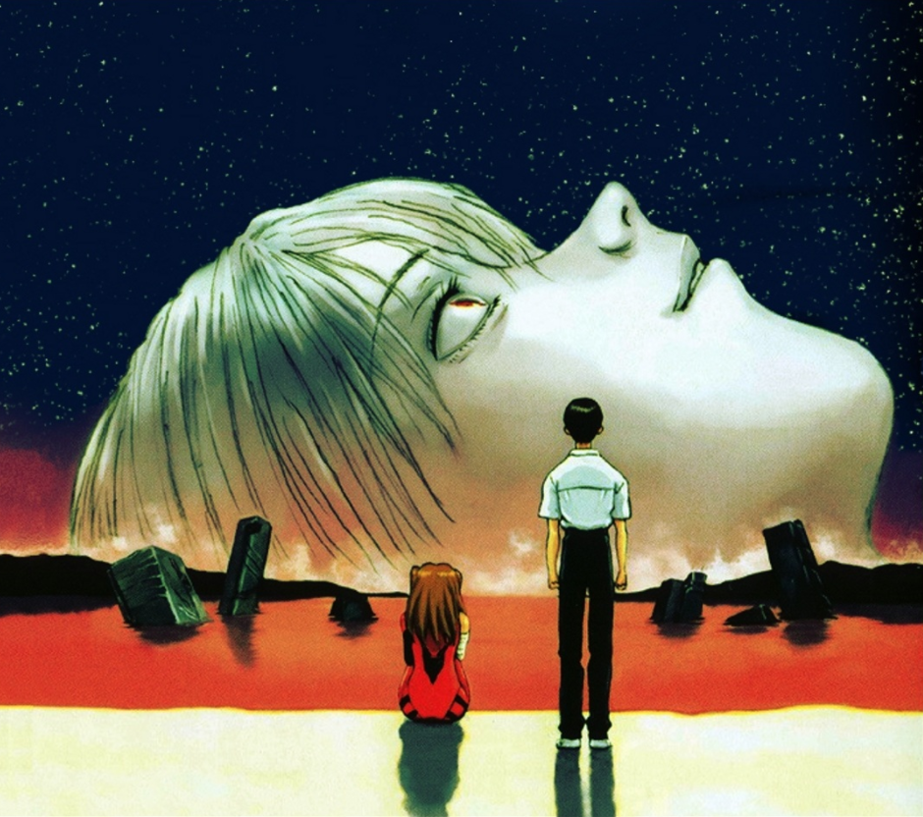

Slide 4
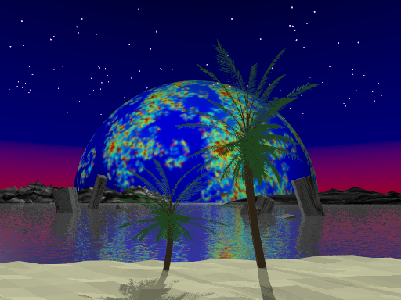

Slide 5
Models
Most of the models used for this composition are original:
Buildings (1 to 5)
Planet
Stars
Sand
Mountains (1 and 2)
Imported models:
Water
Palms

Slide 6
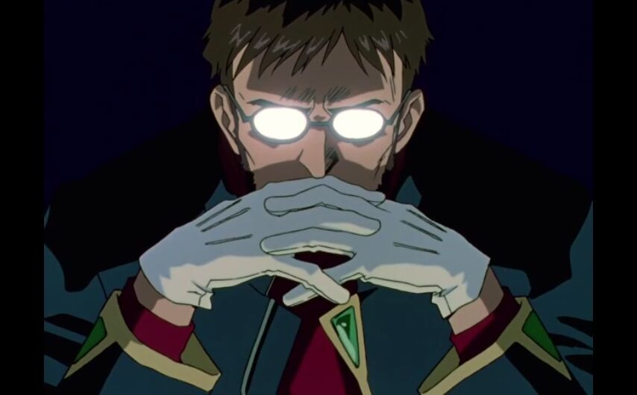
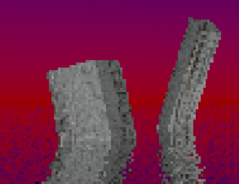
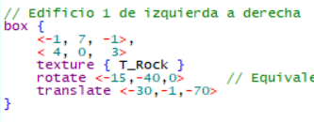
Procedure to create fallen buildings

Slide 7
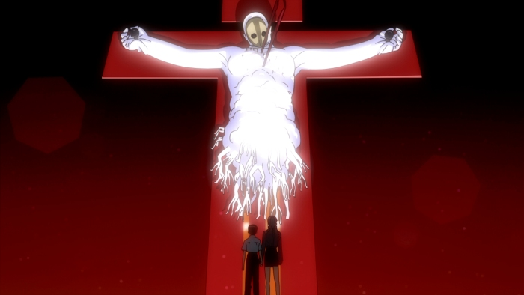
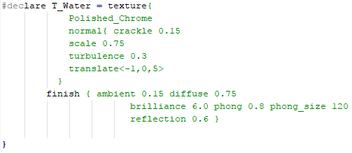
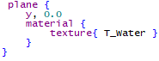
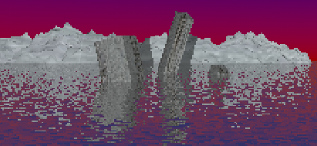
Procedure to create water

Slide 8
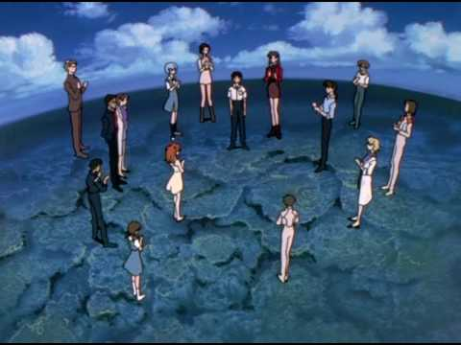
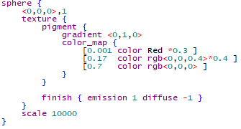
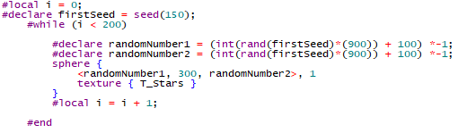
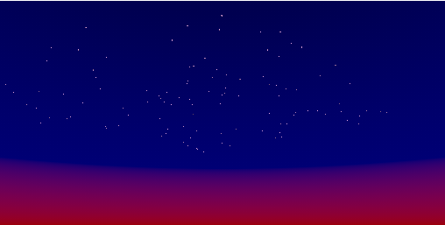
Procedure to create background colors

Slide 9
Layout and Composition
Our layout was based on the described scene, we tried to keep things as close to the inspiration pic as possible so we placed the objects like they are placed in the original scene
The layout consists of a moon with the julia fractal, the sand with random heights, the mountains with mid point interpolation and the rest of the objects to represent the ones in the scene, like the buildings or trees representing the main characters.

Slide 10
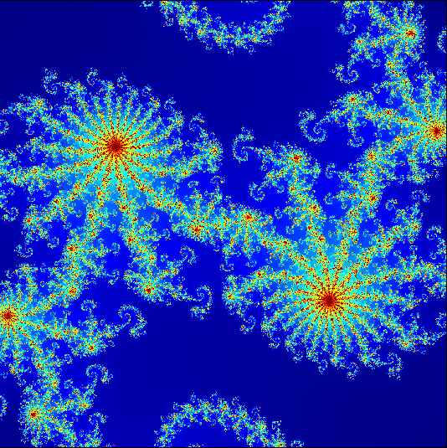
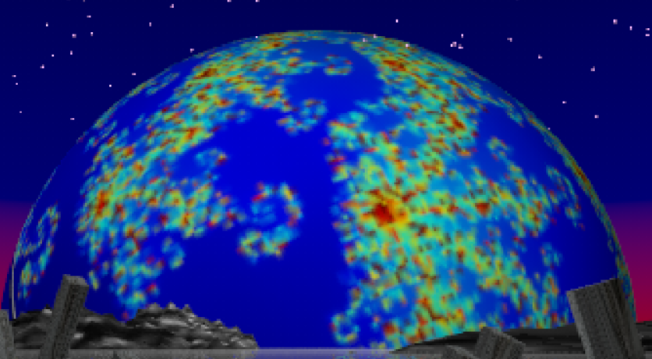
Fractals: Julia

Slide 11
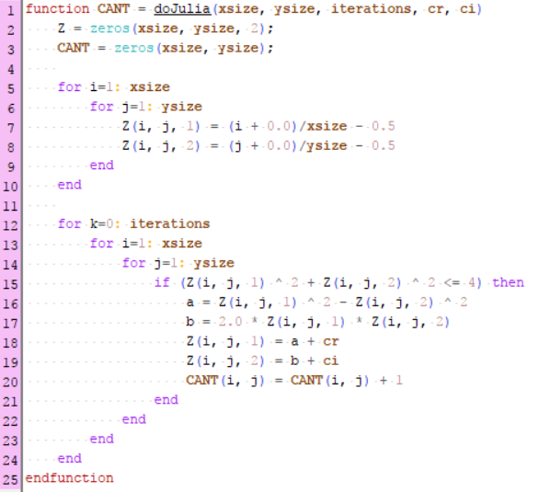
2d - Fractal
xsize = 1200
ysize = 1200
iterations = 720
cr = -0.8
ci = 0.156

Slide 12
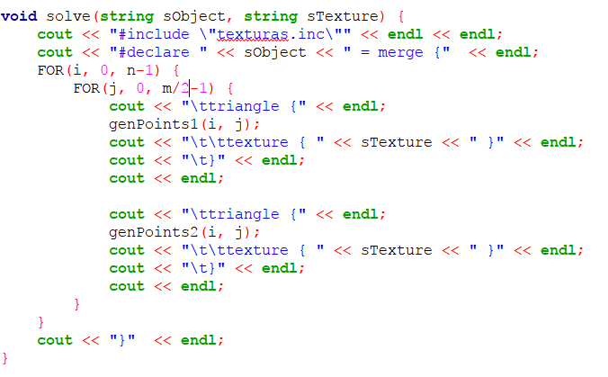
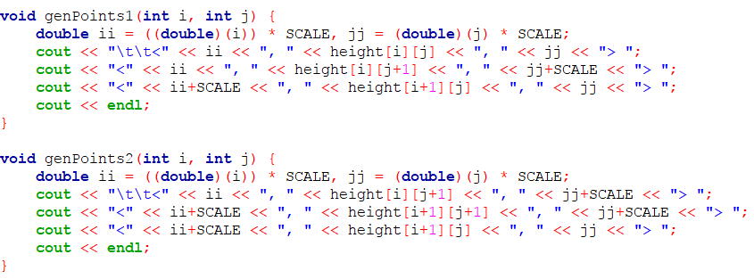
Procedure to generate a Terrain

Slide 13
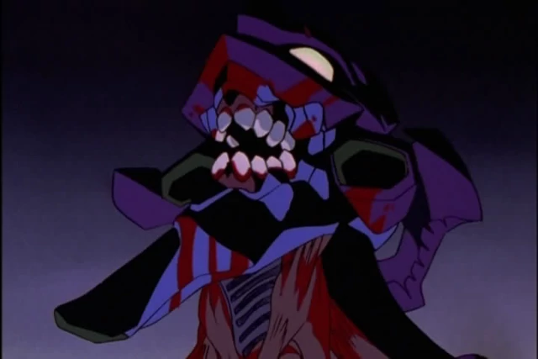
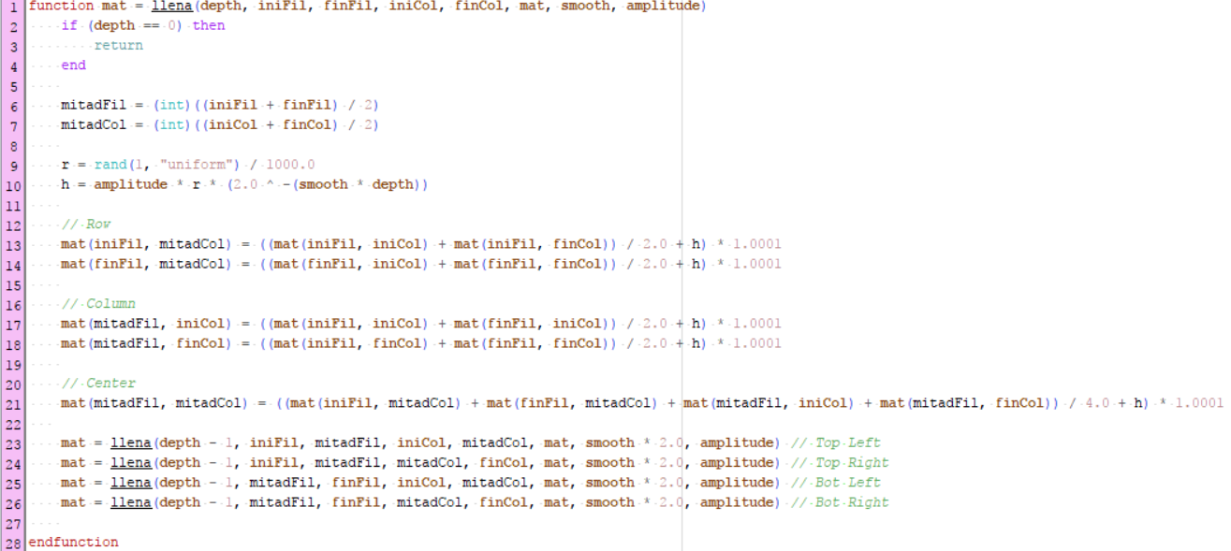
Procedure to create mountains

Slide 14
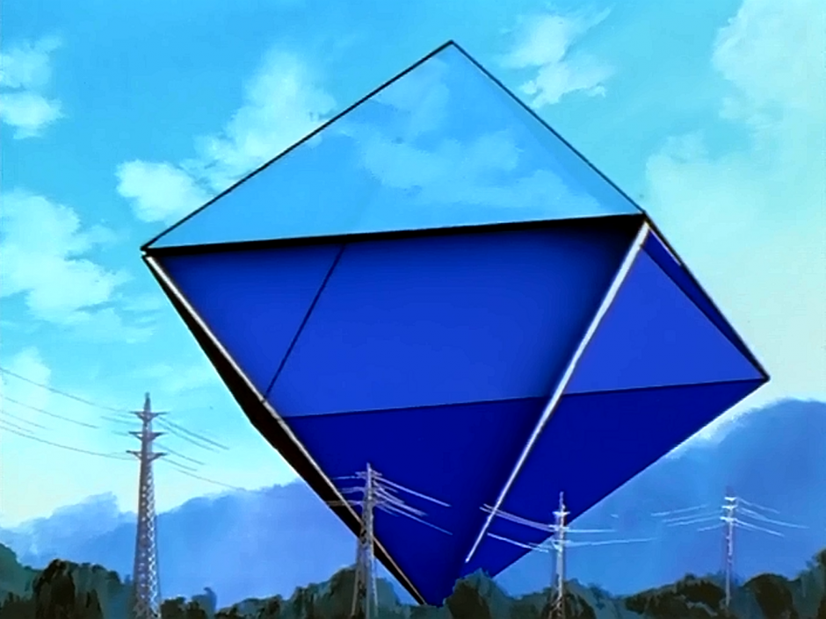
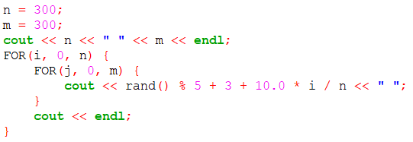
Procedure to create Sand
Random heights which grow depending on it’s further from the sea.

Slide 15
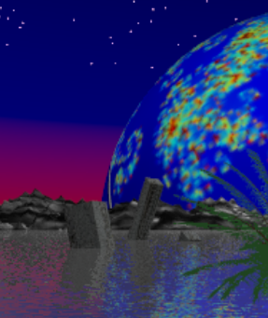
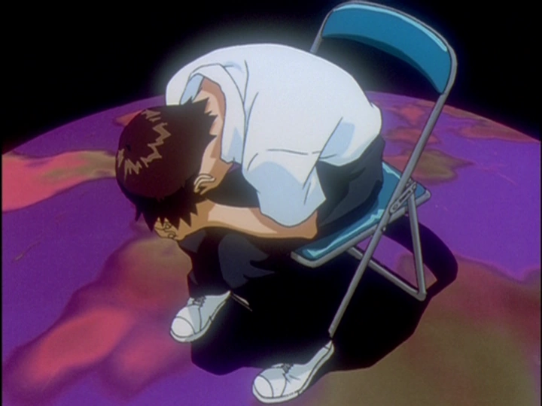
Principles of realism (1-2)
Chaos
Buildings aren't perfectly aligned
Stars aren't perfectly aligned
Sand is not all plane, it has highs and lows everywhere.
Mountains have a smoothness different from 1.0
Personality
Shinji is a very sentimental person who tried to be noticed by his father without achieving it, in all the series till the very end he keeps trying to get some compliment or encouragement words from his father: depressive scene

Slide 16
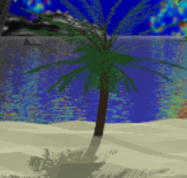
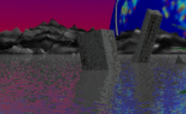
Principles of realism (2-2)
Surface Texture
The mountains have smoothness as one of their attributes when they are built.
The sand, with the help of shadows, look as if it is not just plain.
Flaws, Scratches & Dings
Buildings seem to have scratches because of their demolished state.

Slide 17
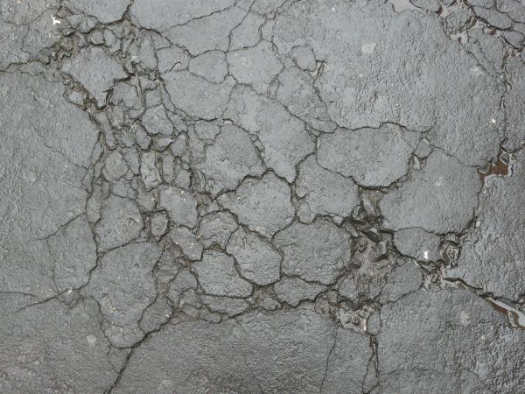

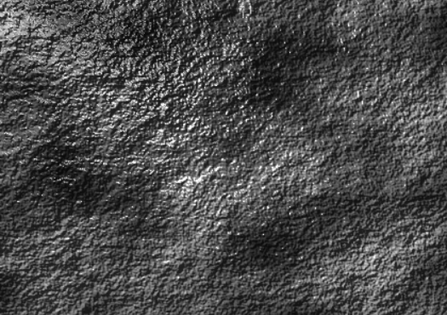


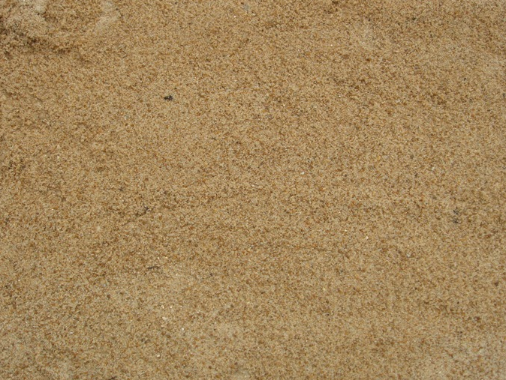



Textures Colour Palette
Buildings
Mountain
Sand
Hexa code
Red #FF0000
Blue #000066
Black #000000
White #FFFFFF
Brown #3F2A14
Green #228B22
The colors fit perfectly the feelings, dark blue color represents sadness and depression, red color represents anger, blood, war and color black means death and loneliness.
The anime itself show us these surrealistic scenes and sad, dull colors, due to the depressive thoughts and the insanity of the main characters.

Slide 18
Camera
• We decided to have 3 views of the scene:
One from the point of view of the original image (angle). This is the most important one because this is the original we want to represent.
One from the point of view of Shinji (point of view). Because Shinji is the main character in the serie, is important to know and understand his position (metaphorically and physically)
One with a higher angle the top, on the side of the land (angle). It shows the sky. We can see the light of the moon.
All cameras have the same aspect ratio: 512 x 384
The shadows in the sand and in the palms help the scene to give it be more realism.

Slide 19
Camera 1: Angle

Slide 20
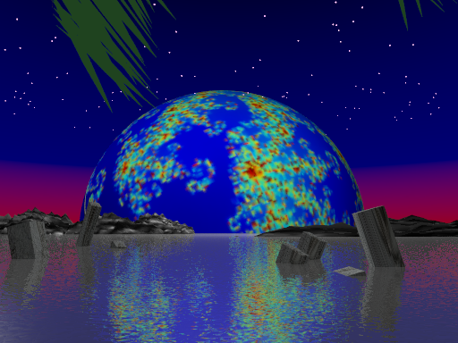
Camera 2: Point of view

Slide 21
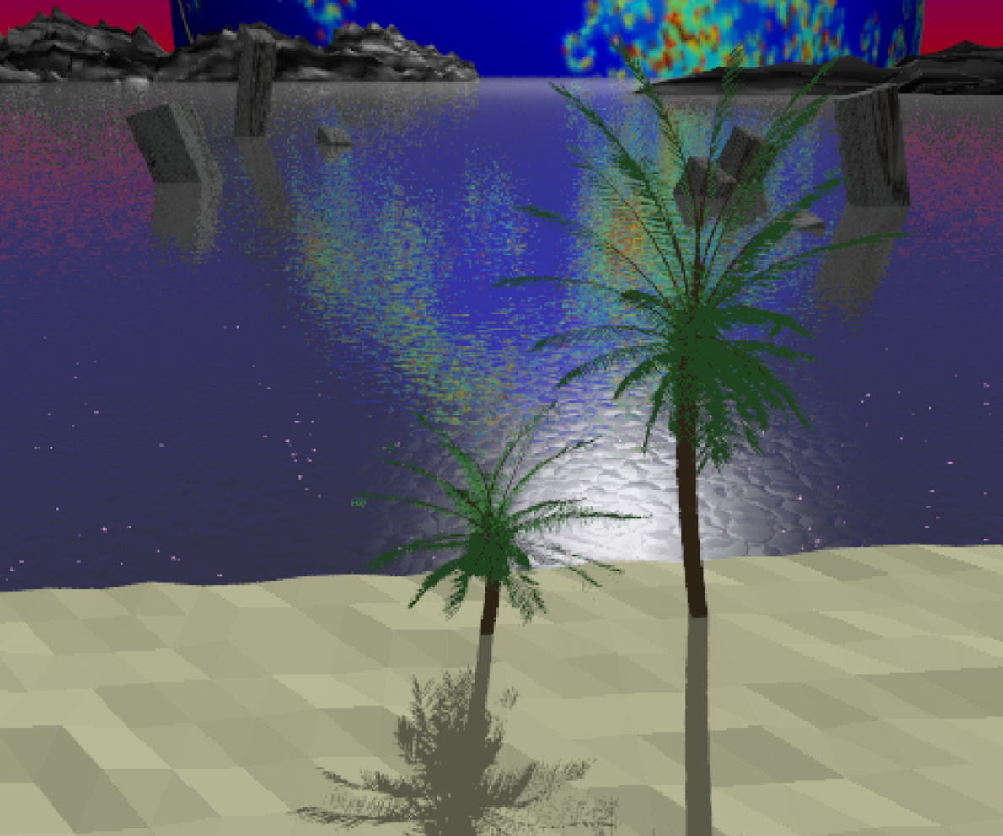
Camera 3: (Areal / Angle)

Slide 22
Illumination
The scene has only 1 natural light source (moon) and it is placed above the fractal.
There is no point to intensify and create more light sources because it will lose the dark and the sense of what the author wanted to represent.
The shadows help the sand to look more realistic, and make the palms look as that they are not floating.

Slide 23
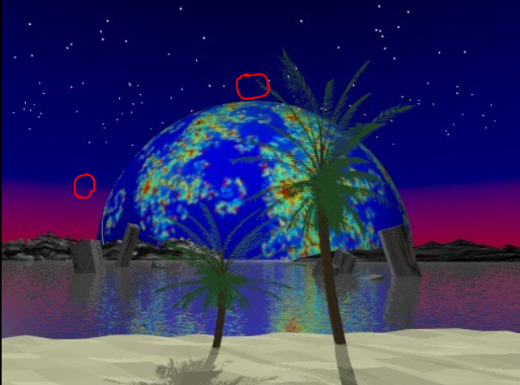
Illumination

Slide 24
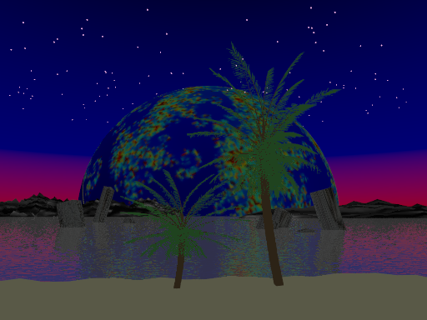
With vs without illumination (1-3)

Slide 25
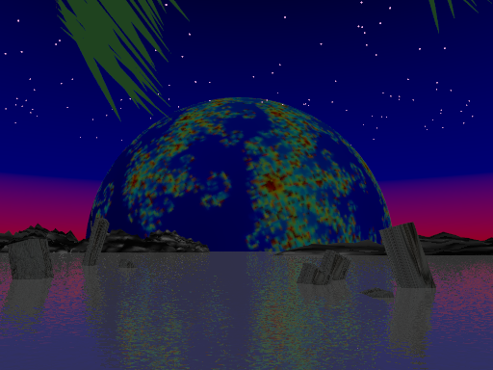
With vs without illumination (2-3)

Slide 26
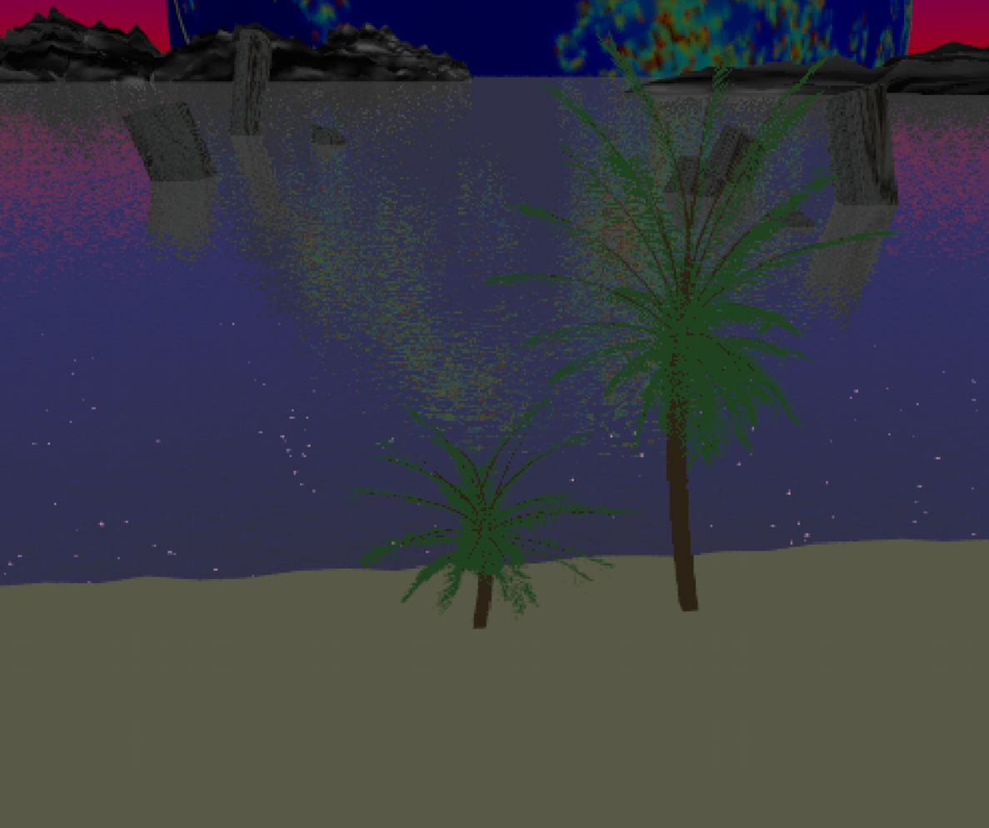
With vs without illumination (3-3)

Slide 27

Conclusions
Technical: In order to achieve a scene that closely resembled the scene of Neon Genesis Evangelion we played around with background colors, illumination and lights as well as object depth and camera angle until we were satisfied with the similarity we achieved.
Ethical: In the anime Shinji’s father shows 0 ethical responsibility. He is willing to do whatever it takes to achieve what he is after even if it means the dead of several people.

Slide 28
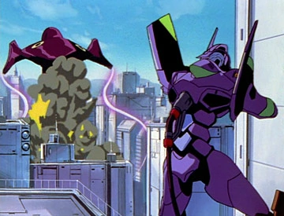
Conclusions
Citizenship: Neon Genesis Evangelion has been critically acclaimed both in japan and outside of japan, the series has gained lots of fans around the world creating a loyal fanbase, it has even give birth to many debates about its various religious symbolism and psychological themes, it is often considered as a Anime classic by various critics.
Environmental: Often in the anime landscapes and environments are fully destroyed when Evas(giant robots) and Angels(giant alien like creatures) fight each other, in general in the animation environment looks destroyed or semi destroyed.

Slide 29
References: Textures and colors (1-2)
Rock texture http://cdn.designbeep.com/wp-content/uploads/2013/09/11.rock-texture.jpg
Meaning of colors: https://www.euroresidentes.com/horoscopos/colores/significado-color-negro.htm
Sand texture http://brentwoodmaterial.com/wp-content/uploads/2011/11/Fine-Meremac-Sand.png
Mountain texture: https://upload.wikimedia.org/wikipedia/commons/a/a7/Stone_gimp.png
Trees: http://arbaro.sourceforge.net/

Slide 30
References: Images (2-2)
https://vignette4.wikia.nocookie.net/evangelion/images/3/3b/Eva-01_berserk_howl.png/revision/latest/scale-to-width-down/640?cb=20120630173753
https://media.nyusu.fm/ranking/option/940/31465.png
https://i.ytimg.com/vi/Bs8U6I-Z7Zo/hqdefault.jpg
http://www.bogleech.com/scrapbook/angel-lilith2.jpg
http://pm1.narvii.com/6529/e4add2e37929cf8c82afeab538d7aaed5e844187_hq.jpg
http://www.sbs.com.au/popasia/sites/sbs.com.au.popasia/files/end-of-evangelion.jpg
https://31.media.tumblr.com/af4b594a46761340132635fc71a5448a/tumblr_inline_mnqu21TYJ21qz4rgp.jpg
https://static.vix.com/es/sites/default/files/styles/large/public/btg/comics.batanga.com/files/5-cosas-que-debes-saber-sobre-Evangelion-para-entenderlo-un-poco-mejor.png?itok=I5sWs3nL
http://vignette1.wikia.nocookie.net/evangelion/images/2/2e/Shinji_PCH.png/revision/latest?cb=20130502152628&path-prefix=es
https://forgottenadvertisements.files.wordpress.com/2012/04/penpeneat.jpg
http://2.bp.blogspot.com/-_9cDcPpb-Ow/Tv9eEmfhucI/AAAAAAAABoo/VeP3uQFRzME/s1600/wtf_shinji.jpg

